Slide 1

Apache Kafka Session - 2

Slide 2
RAGUNATH MUTHU
BSOL SYSTEMS PRIVATE LIMITED

Slide 3
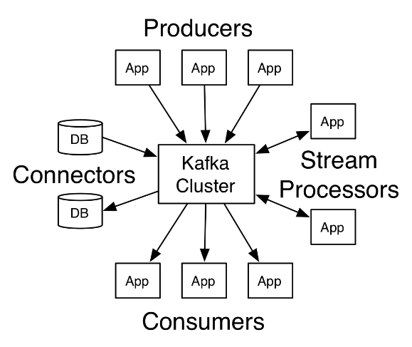
APACHE KAFKA
Producer API
Consumer API
Streams API
Connector API
HE KAFKA​

Slide 4
APACHE KAFKA
KAFKA PRODUCER :
Instances of an application that publishes data to the topics of their choice and responsible for choosing which record to store in which topic and which partition.
HE KAFKA​

Slide 5
APACHE KAFKA
KAFKA CONSUMER :
Only metadata saved in the consumer is offset position of partition, in other words position of that consumer in logs
Consumer controls the offset position for streaming so it can advance linearly, or it can consume records in any order it wants
HE KAFKA​

Slide 6
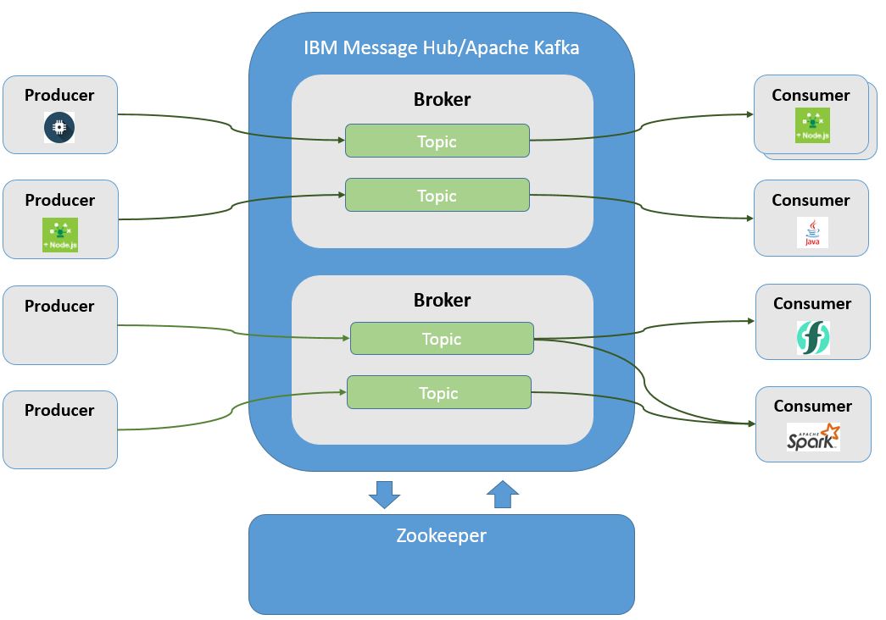
KAFKA PRODUCER&
KAFKA CONSUMER

Slide 7
APACHE KAFKA
KAFKA STREAM :
Kafka Streams is a client library for building applications and microservices, where the input and output data are stored in a Apache Kafka® cluster.
HE KAFKA​

Slide 8
APACHE KAFKA
KAFKA CONNECT :
Kafka Connect is a framework included in Apache Kafka that integrates Kafka with other systems.
Its purpose is to make it easy to add new systems to your scalable and secure stream data pipelines KAFKA​

Slide 9
APACHE KAFKA
SOURCE KAFKA CONNECT :
A source connector ingests entire databases and streams table updates to Kafka topics.
It can also collect metrics from all of your application servers into Kafka topics, making the data available for stream processing with low latency.

Slide 10
APACHE KAFKA
SINK KAFKA CONNECT :
A sink connector delivers data from Kafka topics into secondary indexes such as Elasticsearch or batch systems such as Hadoop for offline analysis.

Slide 11
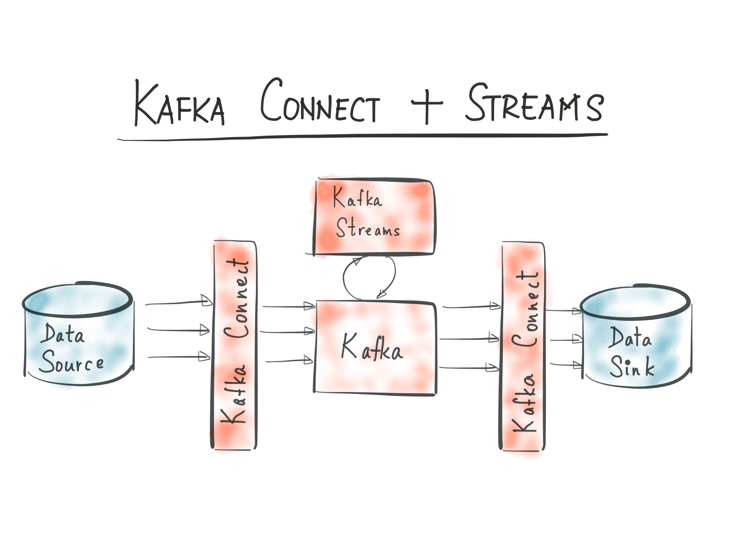
KAFKA STREAM &
KAFKA CONNECT

Slide 12
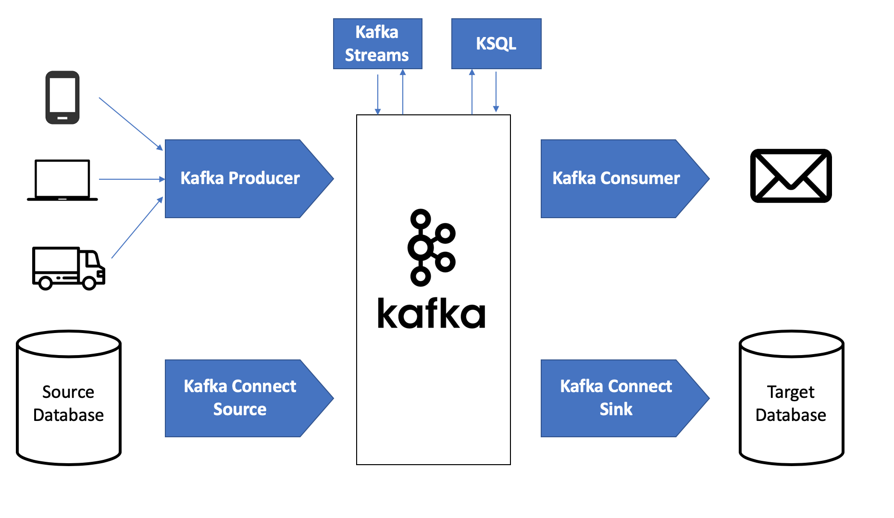
KAFKA STREAM &
KAFKA CONNECT

Slide 13
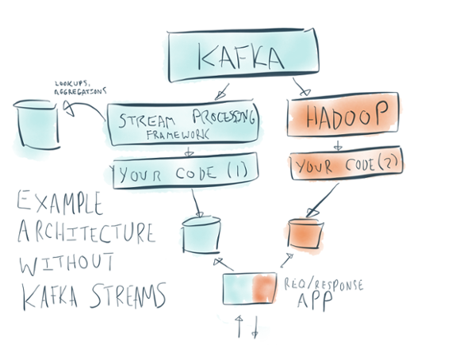
KAFKA STREAM

Slide 14




KAFKA STREAM

Slide 15
Apache Kafka
Message Queueing Service ??
Streaming Platform ??

Slide 16
KAFKA
AS
MESSAGE QUEUING
SERVICE
SERVICE 1
SERVICE 2
SERVICE 3
KAFKA
MESSAGE QUEUE MIDDLEWARE
CONSUMER1
CONSUMER 2
CONSUMER 3

Slide 17
KAFKA
AS STREAMING Platform
APPLICATION
DATA
DATABASE / FILE STORAGE
STREAM PROCESSING
KAFKA
PROCESSED DATA

Slide 18
APACHE KAFKA
KAFKA Domain specific language :
The Kafka Streams DSL (Domain Specific Language) is built on top of the Streams Processor API. It is the recommended for most users, especially beginners.
Most data processing operations can be expressed in just a few lines of DSL code.
KAFKA​

Slide 19
APACHE KAFKA
KAFKA DSL NOTIONS:
KStream
KTable
GlobalKTable
KAFKA​

Slide 20
APACHE KAFKA
KSTREAM:
A KStream is an abstraction of a record stream, where each data record represents a self-contained datum in the unbounded data set.
KAFKA​

Slide 21
APACHE KAFKA
KTABLE:
A KTable is an abstraction of a changelog stream, where each data record represents an update.KA

Slide 22
APACHE KAFKA – KTABLE & KSTREAM
In Initial, Bob has $200 and Alice has $450
Sequence of transaction happens between both
a. Alice transacts $100 to Bob
b. Bob transacts $50 to Alice
c. Bob transacts $100 to Alice
C. STREAM WILL HAVE AFTER SEQUENCE a:
a. Alice || $100 to Bob
D. TABLE WILL HAVE AFTER SEQUENCE a:
a. Alice || $350, Bob || $300
E. CHANGE LOG THAT CAN BE CREATED FROM TABLE, CAN BE SENT TO STREAM AGAIN AFTER SEQUENCE a:
a. Alice has $350 and Bob has $300
F. STREAM WILL HAVE AFTER SEQUENCE b:
b. Alice || $100 to Bob, Bob || $50 to Alice

Slide 23
APACHE KAFKA
G. TABLE WILL HAVE AFTER SEQUENCE b:
b. Alice || $400, Bob || $250
H. CHANGE LOG THAT CAN BE CREATED FROM TABLE CHANGES FROM TABLE CREATION, CAN BE SENT TO STREAM AGAIN AFTER SEQUENCE b:
b. Alice has $350 and Bob has $300, Alice has $400 and Bob has $250
I. STREAM WILL HAVE AFTER SEQUENCE c:
c. Alice || $100 to Bob, Bob || $50 to Alice, Bob || $100 to Alice
J. TABLE WILL HAVE AFTER SEQUENCE c:
c. Alice || $500, Bob || $150
K. CHANGE LOG THAT CAN BE CREATED FROM TABLE CHANGES FROM TABLE CREATION, CAN BE SENT TO STREAM AGAIN AFTER SEQUENCE c:
c. Alice has $350 and Bob has $300, Alice has $400 and Bob has $250, Alice has $500 and Bob has $150

Slide 24
APACHE KAFKA
GLOBALKTABLE:
Like a KTable, a GlobalKTable is an abstraction of a changelog stream, where each data record represents an update.
A GlobalKTable differs from a KTable in the data that they are being populated with, i.e. which data from the underlying Kafka topic is being read into the respective table
Slightly simplified, imagine you have an input topic with 5 partitions. In your application, you want to read this topic into a table.

Slide 25
APACHE KAFKA
KAFKA GLOBALKTABLE:
Also, you want to run your application across 5 application instances for maximum parallelism.
If you read the input topic into a KTable, then the "local" KTable instance of each application instance will be populated with data from only 1 partition of the topic's 5 partitions.
If you read the input topic into a GlobalKTable, then the local GlobalKTable instance of each application instance will be populated with data from all partitions of the topic.

Slide 26
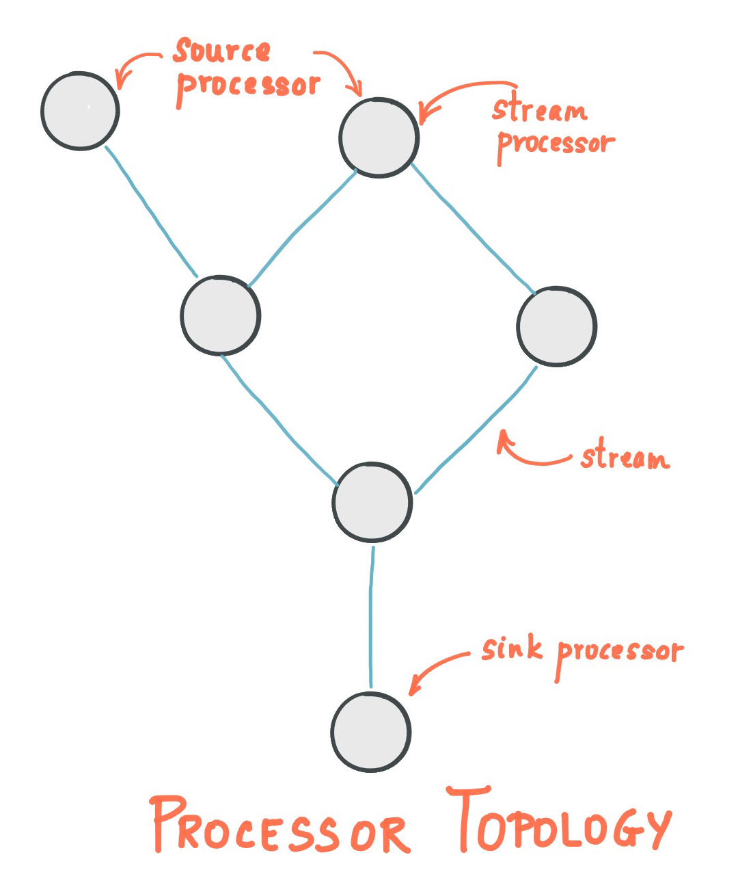
KAFKA-DSL TOPOLOGY

Slide 27
APACHE KAFKA
KAFKA STREAM TRANFORMATIONS:
Stateful Transformation
Stateless Transformation

Slide 28
APACHE KAFKA
KAFKA STATEFULL TRANFORMATIONS:
FlatMap
Filter
ForEach
GroupByKey
GroupBy

Slide 29
APACHE KAFKA
KAFKA STATELESS TRANFORMATIONS:
Aggregate
Join
Window

Slide 30
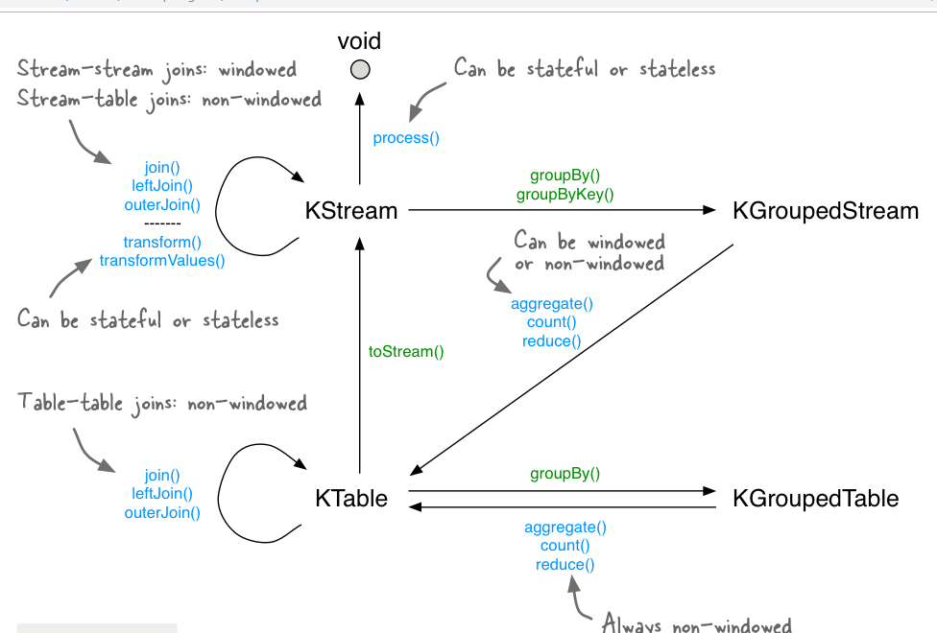
KAFKA STATELESS TRANSFORMATION RELATIONSHIP

Slide 31
CONFLUENT KAFKA
Founded by the team that built Apache Kafka® delivers a complete execution of Kafka for the Enterprise
Confluent Platform
completes Apache Kafka.
Distributed , scalable, elastic, and fully fault-tolerant stream processing platform maintained by Confluent cloud team

Slide 32
CONFLUENT KAFKA
CONTROL CENTRE
KSQL
REST PROXY
KAFKA CLIENTS
SECURITY CONTROLS
KAFKA CONNECT
MQTT PROXY

Slide 33



CONFLUENT KAFKA

Slide 34

APACHE KAFKA

Slide 35

APACHE KAFKA

